Slide 1
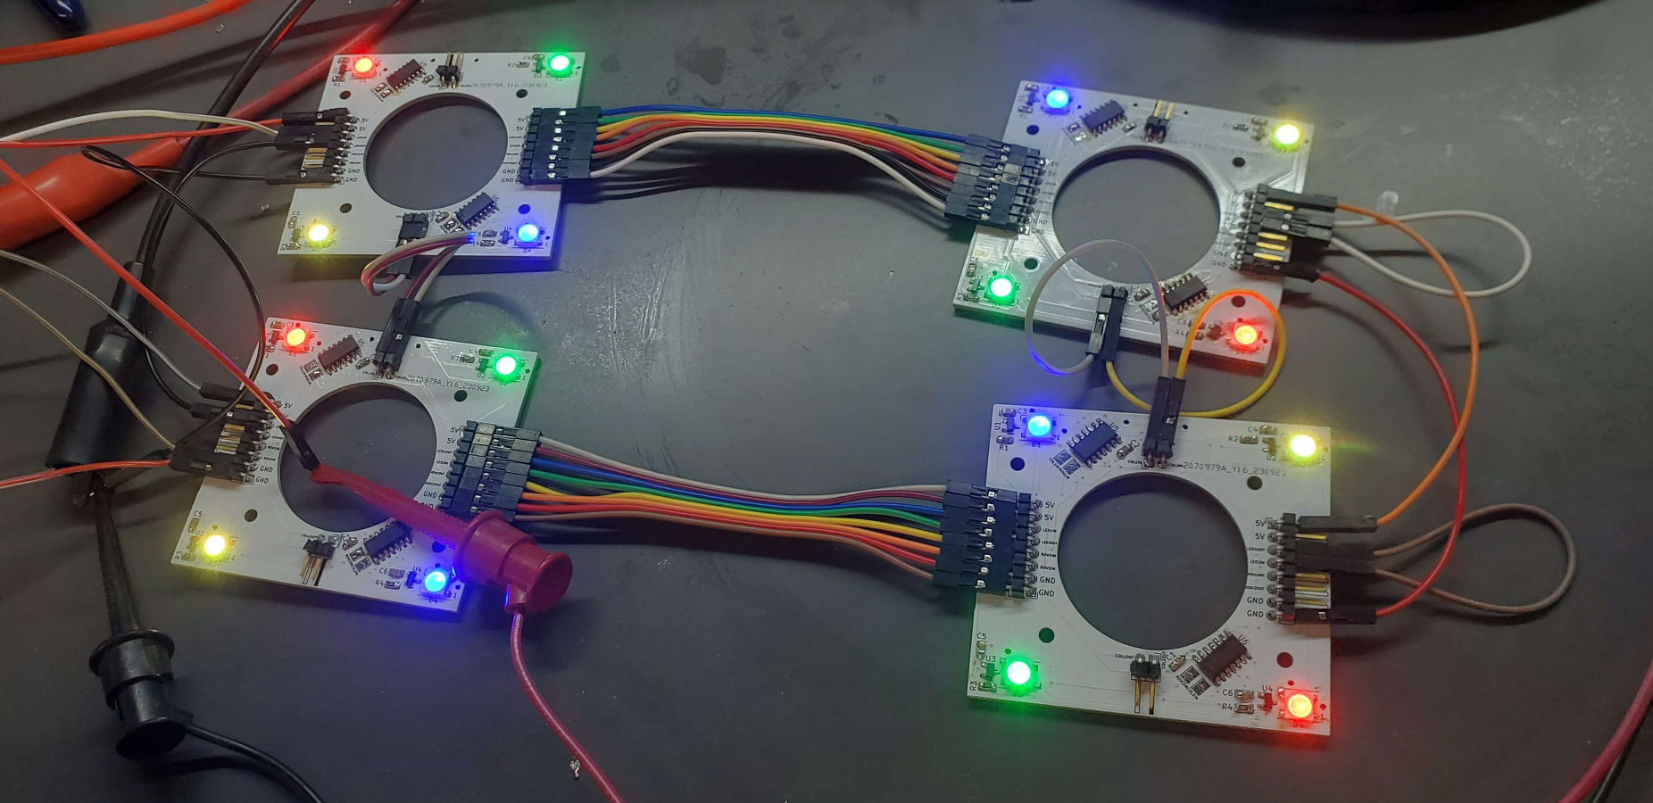
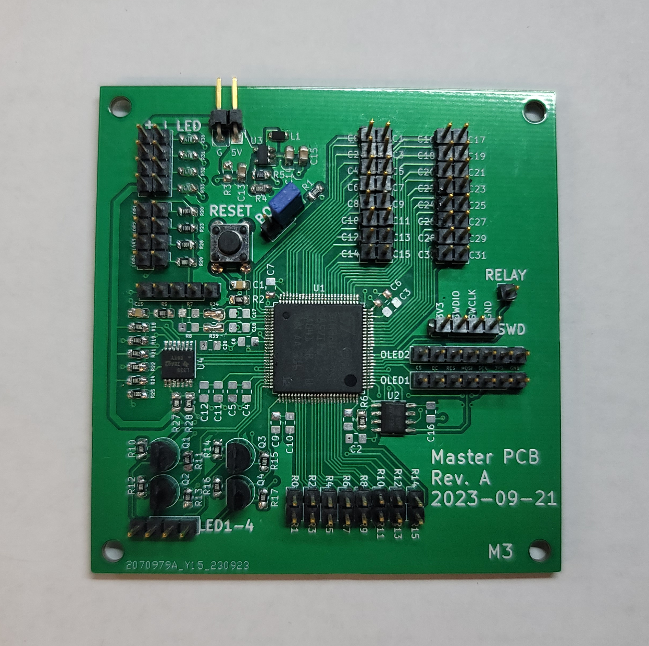
Midterm Design Review
Team 05 – Smart Air Hockey Table

Slide 2
Outline
Project Overview
Major Components
Block Diagram
Packaging Design
Electrical Schematic – Master PCB
PCB Layout – Master PCB
Electrical Schematic – Sensor PCB
PCB Layout – Sensor PCB
Prototyping Progress
Software Development Status
Project Timeline
Questions

Slide 3
Project Overview

Slide 4
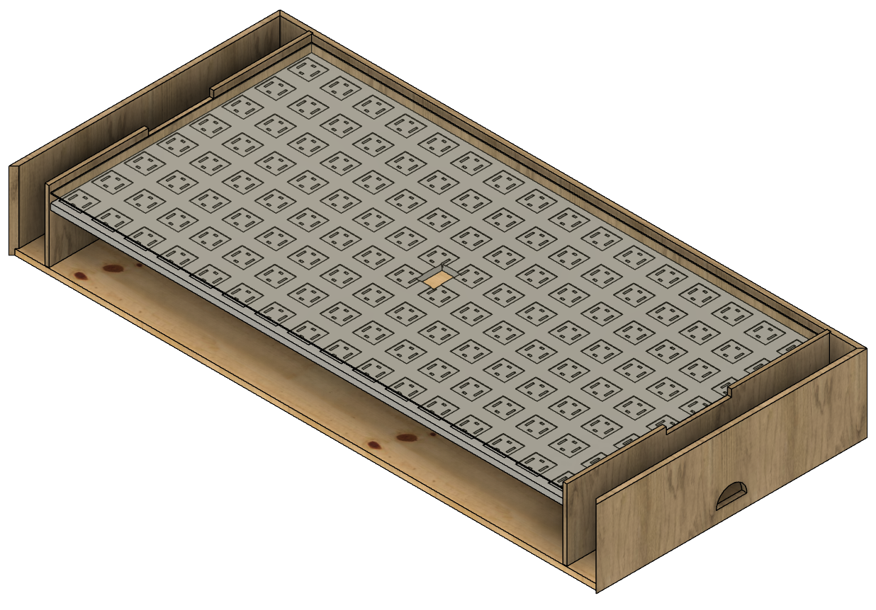
Smart Air Hockey Table (SAHT)
Enhanced Gameplay: Blends air hockey with tech
Dynamic RGB LED Grid: LEDs provide visual feedback
Precise Puck Tracking: Grid of Hall Effect sensors under the playing surface to ensure accurate real-time tracking of a puck embedded with a magnet
Goal Detection: LDR and LED pairs for score detection
OLED Score Display: Side display for score tracking
Power Supply: Power the table from a wall outlet

Slide 5
PSDRs
PSDR #1 (Hardware): An ability for the microcontroller to determine the puck’s position on the playing surface by interpreting signals from a grid of hall effect switches beneath it, using digital gates to consolidate individual signals into row and column bit vectors.
PSDR #2 (Hardware): An ability for the microcontroller to automatically detect goals scored using an LED and analog photoresistor pair digitized using a comparator installed at each goal.
PSDR #3 (Hardware): An ability for the microcontroller to display game score on an OLED display using the SPI protocol.
PSDR #4 (Hardware): An ability for the microcontroller to control a large grid of individually-addressable WS2812B RGB LEDs beneath the playing surface using the LED’s custom communication protocol.
PSDR #5 (Hardware): An ability to provide power to the microcontroller at 3.3V using a buck converter from a 5V source.

Slide 6
Major Components

Slide 7
Major Electrical Components
Microcontroller
RGB LEDs
OLED Display
Hall Effect Sensor
Buck Converter
EEPROM
Power

Slide 8
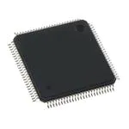
Microcontroller STM32U585VIT6
Familiarity and support of the ecosystem
Reasonable Operating Frequency of 160 MHz
Large Flash Size of 2048 kB
83 Total I/Os (> 73 GPIO Pins)
3.3V Operating Voltage (19.5 uA/MHz)
Standby mode that runs on 210 nA

Slide 9
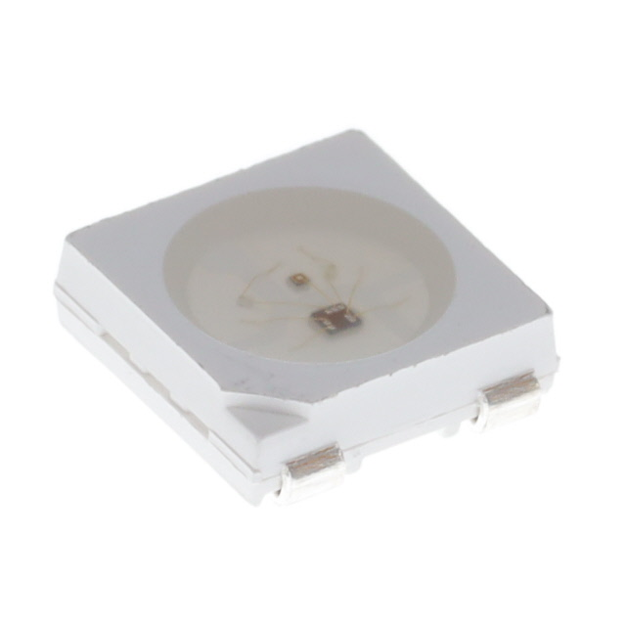
RGB LEDs WS2812B
Common for individually addressable RGB LEDs
Controlled with a custom serial protocol
Very vibrant
Relatively cheap
5V Operating Voltage

Slide 10
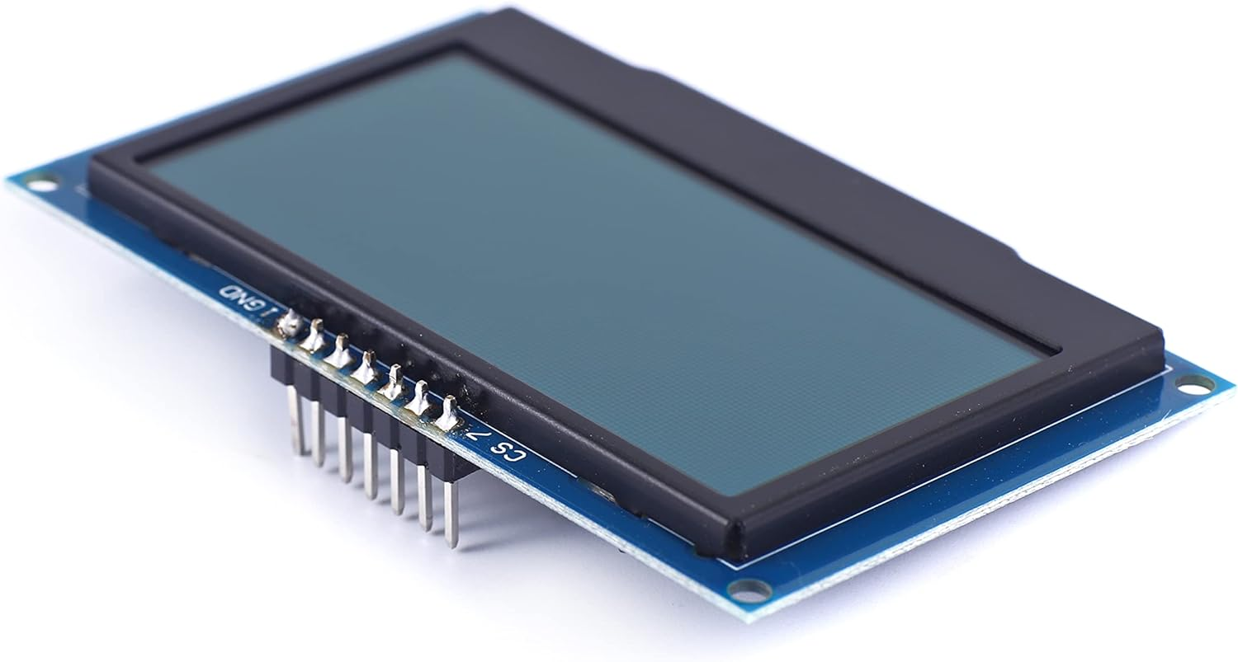
OLED Display SSD1309
Ease of use, similar model available in ECE lab kit
Controlled over SPI
Runs on 3.3V
Resolution of 128 x 64 pixels

Slide 11
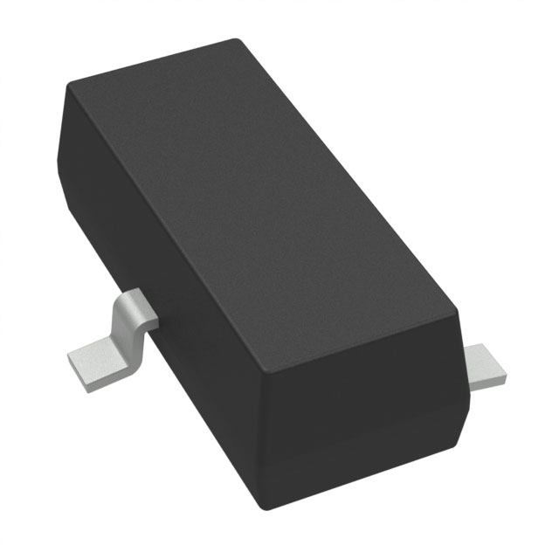
Hall Effect Sensors DRV5033FAQDBZR
Digital Omnipolar Magnetic Switch
Responds the same to both N & S magnetic fields
Large operating voltage range, will run on 5V
Open drain output
Fast output delay time, typ of 13 us and max of 25 us

Slide 12
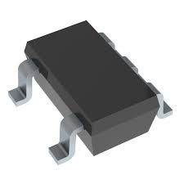
Buck Converter TLV62568DBVR
High Efficiency Buck Converter
2.2V to 5.5V Input Voltage Range
Adjustable Output Voltage Range from 0.6V to V_in
Will be set to 3.3V
Up to 95% Efficient

Slide 13
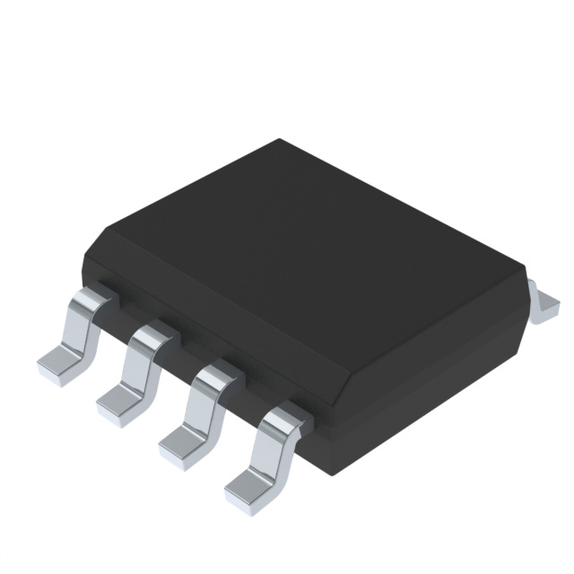
EEPROM M95P32-IXMNT
High-speed, high-capacity SPI EEPROM
Up to 80 MHz clock frequency
32 Mbit capacity
Controlled via SPI
Small footprint (SOIC-8)

Slide 14
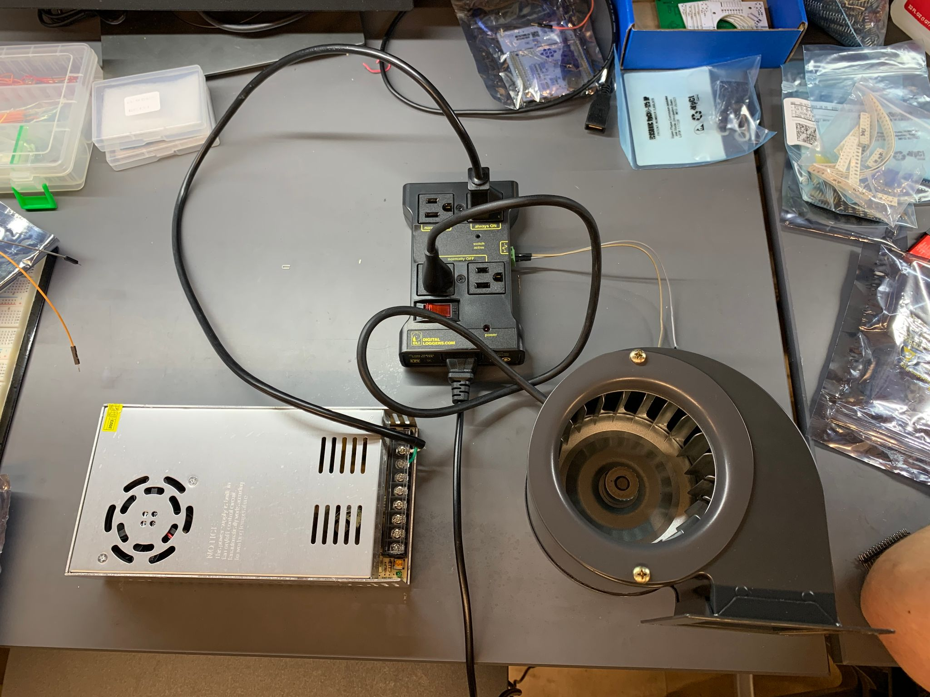
Supplementary OTS Power and Blower
120VAC to 5VDC power supply
Centrifugal Blower Fan
IoT outlet relay

Slide 15
Block Diagram

Slide 16
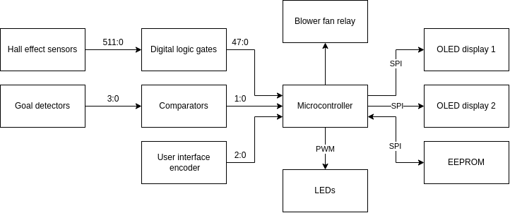
Block Diagram

Slide 17
Packaging Design

Slide 18
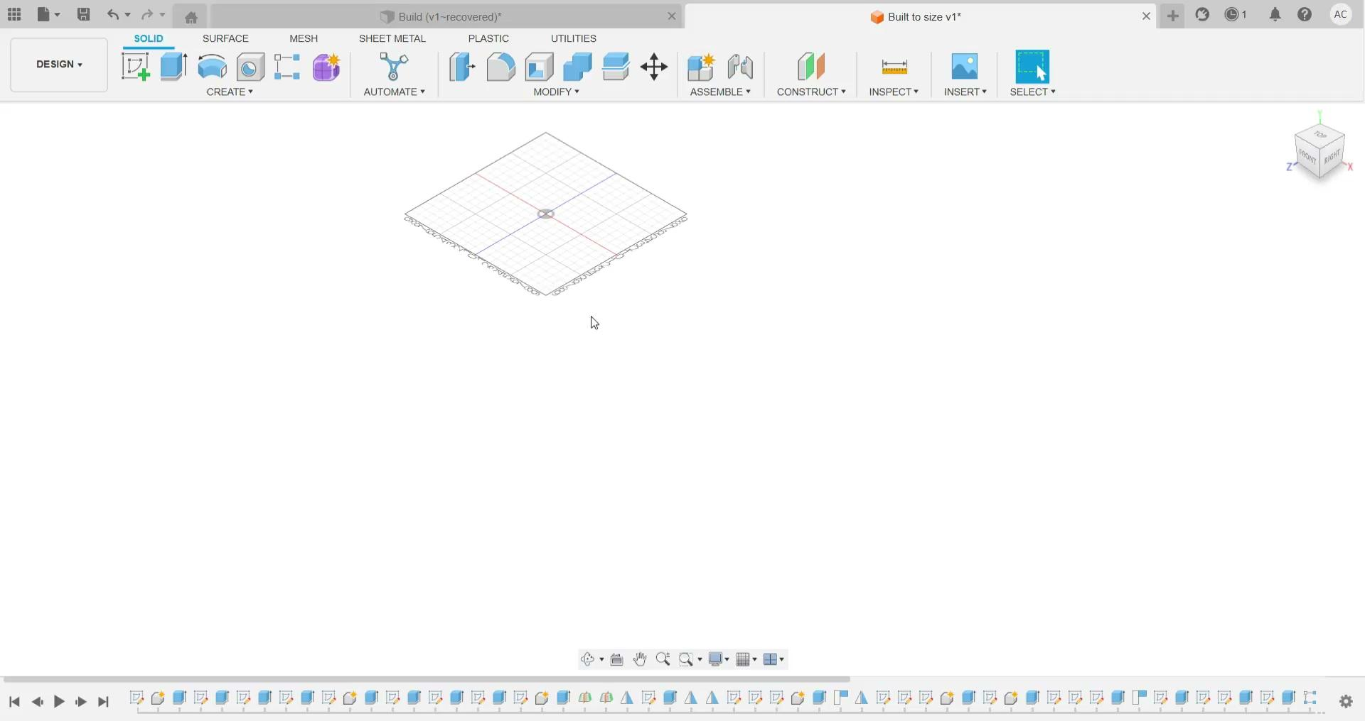
Packaging Design
Dimensions
Overall table:
Thickness: 9 ½”
Width: 33 ¼”
Length: 72”
Playing surface:
Width: 32”
Length: 63”

Slide 19
Electrical Schematic – Master PCB

Slide 20
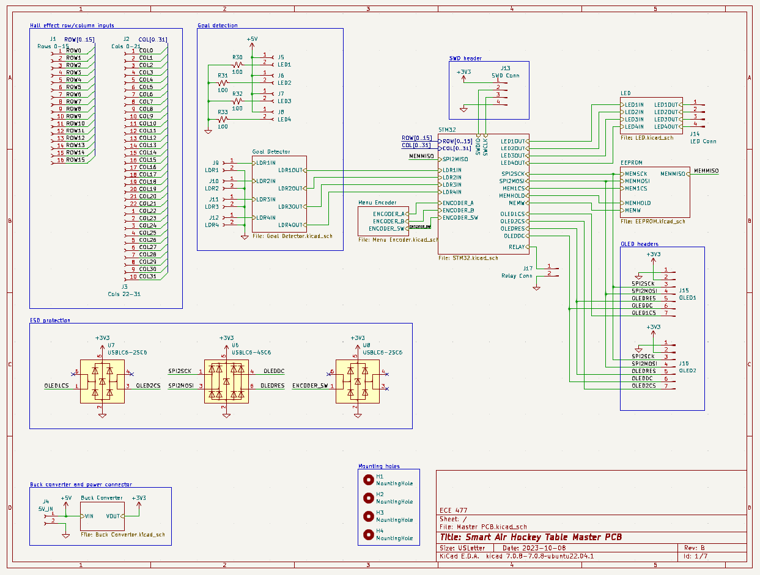
Electrical Schematic: Master PCB
Overview
Notes:
Mention block diagram

Slide 21
Electrical Schematic: Master PCB
STM32

Slide 22
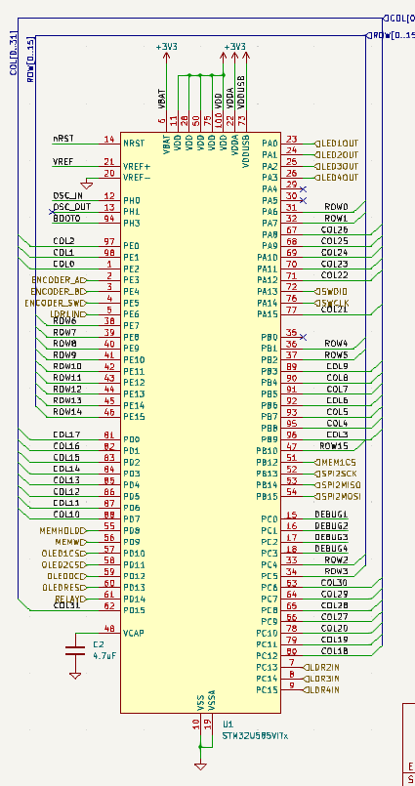
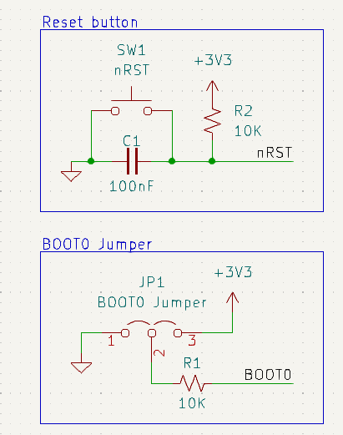
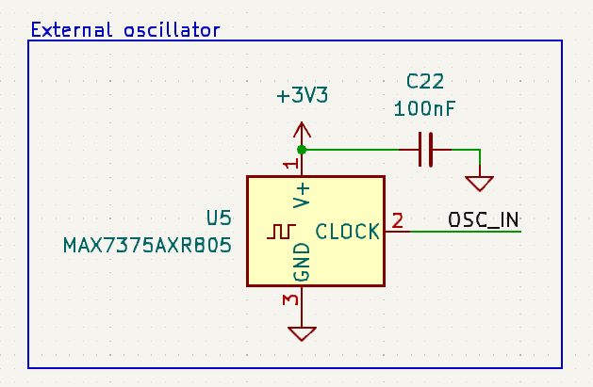
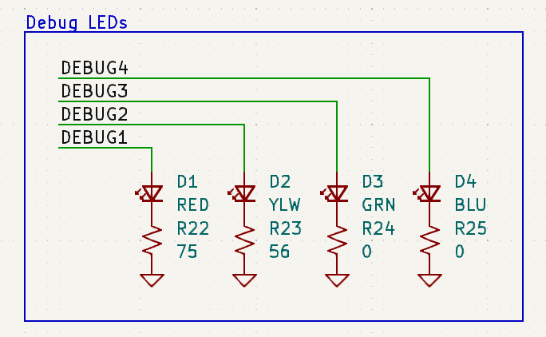
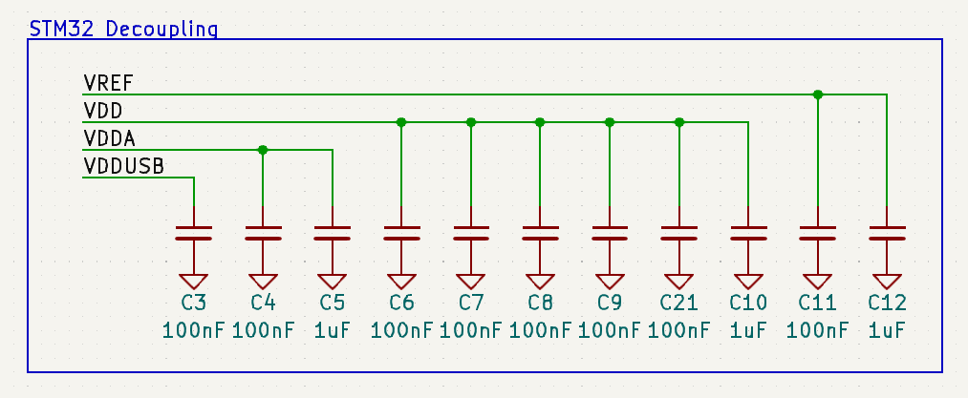
Electrical Schematic: Master PCB
STM32

Slide 23
Electrical Schematic: Master PCB
Buck Converter

Slide 24
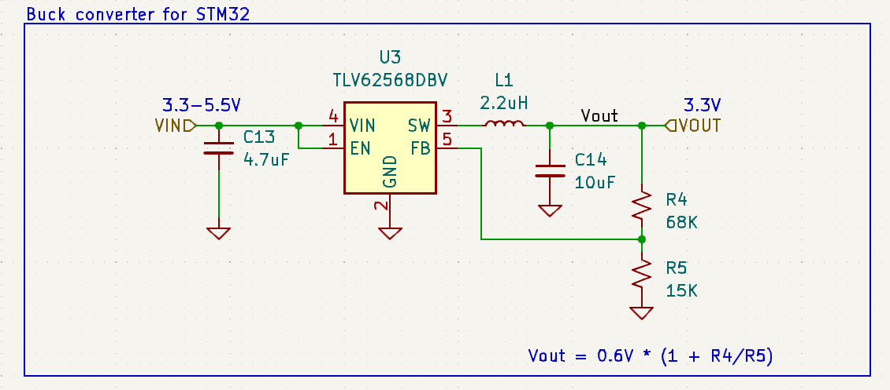
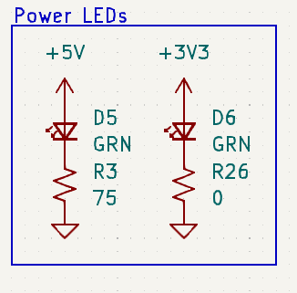
Electrical Schematic: Master PCB
Buck Converter

Slide 25
Electrical Schematic: Master PCB
Goal Detection

Slide 26
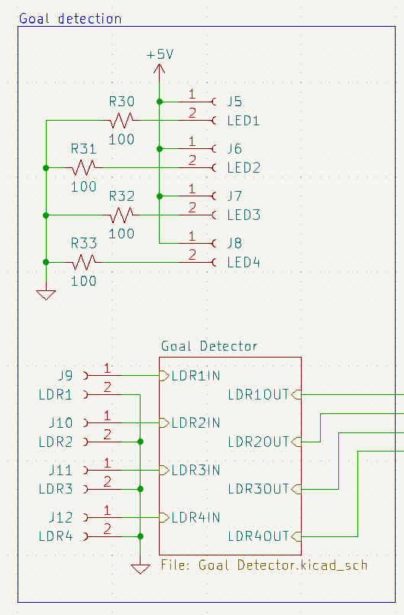
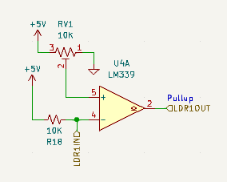
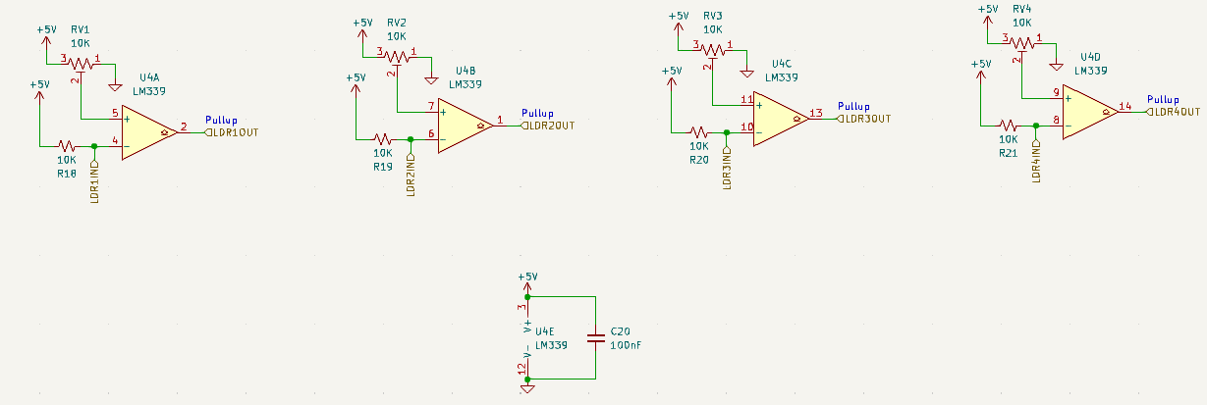
Electrical Schematic: Master PCB
Goal Detection

Slide 27
Electrical Schematic: Master PCB
Menu Encoder

Slide 28
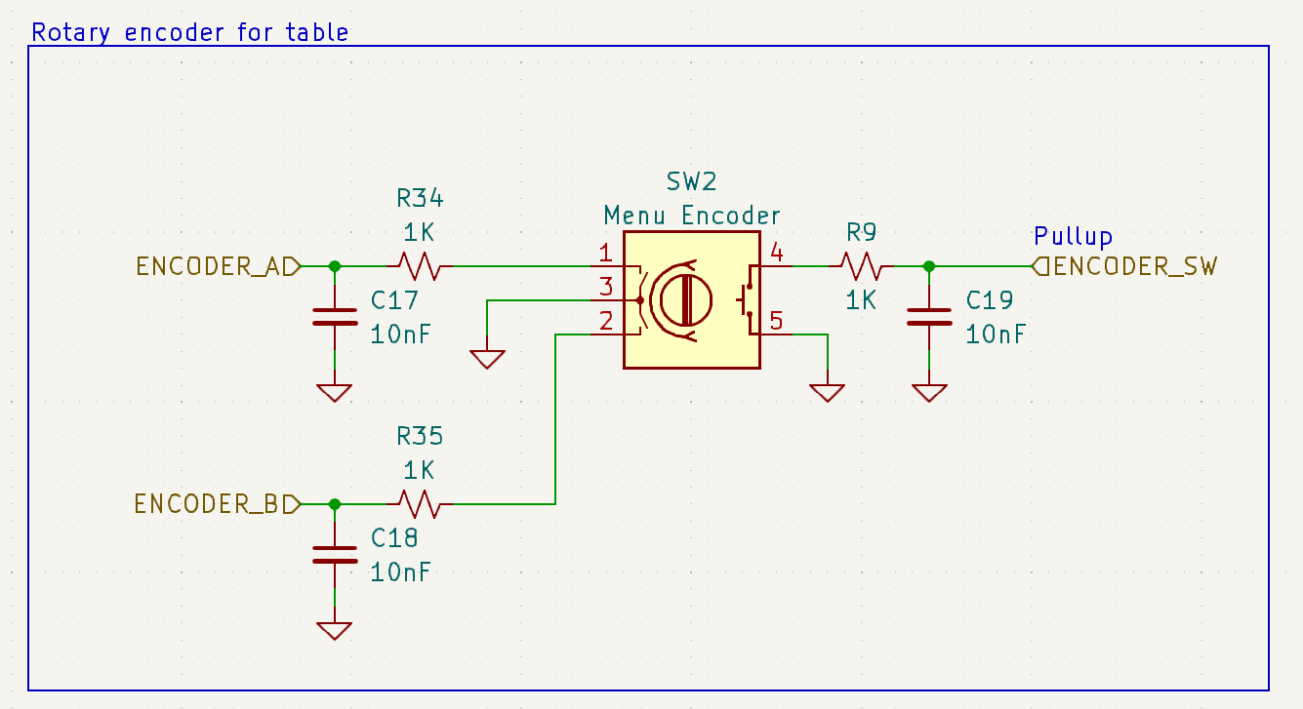
Electrical Schematic: Master PCB
Menu Encoder

Slide 29
Electrical Schematic: Master PCB
LED Level Shifters

Slide 30
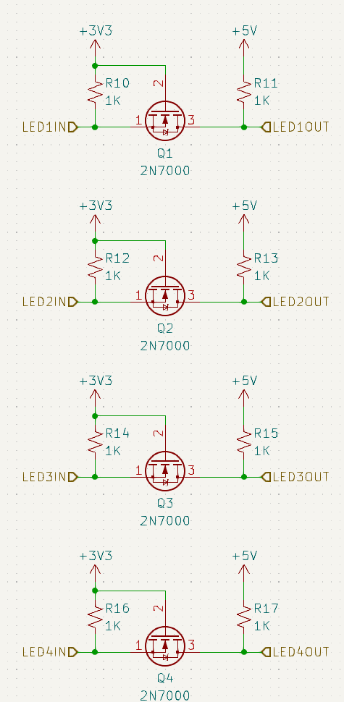
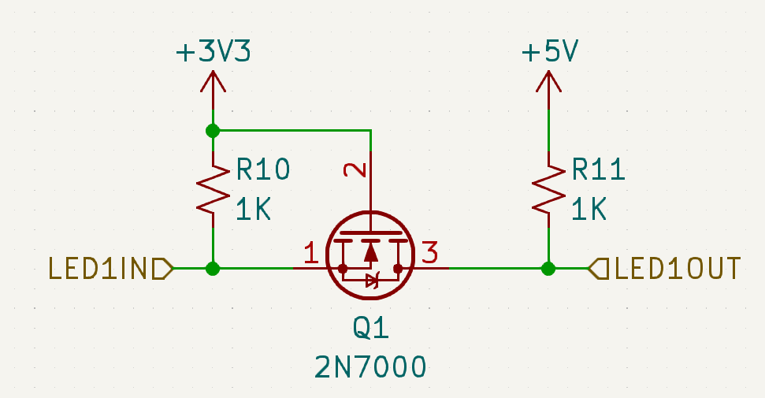
Electrical Schematic: Master PCB
LED Level Shifters

Slide 31
Electrical Schematic: Master PCB
EEPROM

Slide 32
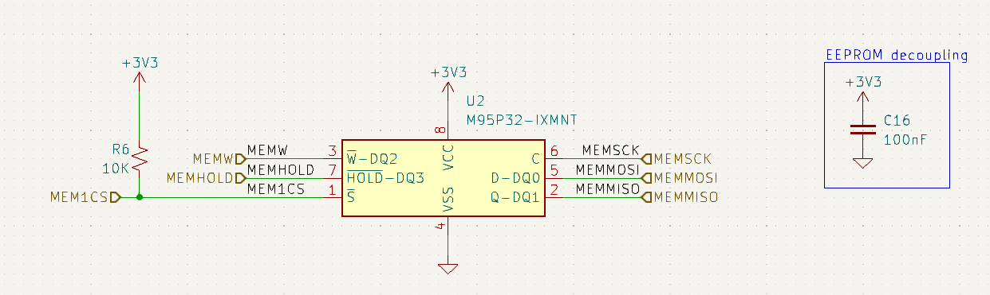
Electrical Schematic: Master PCB
EEPROM

Slide 33
Electrical Schematic: Master PCB
ESD Protection

Slide 34
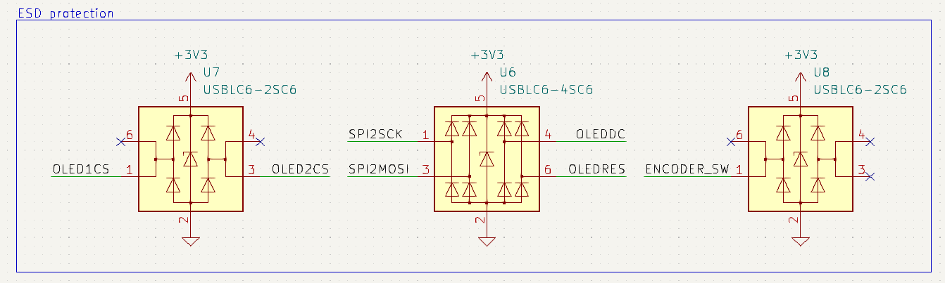
Electrical Schematic: Master PCB
ESD Protection

Slide 35
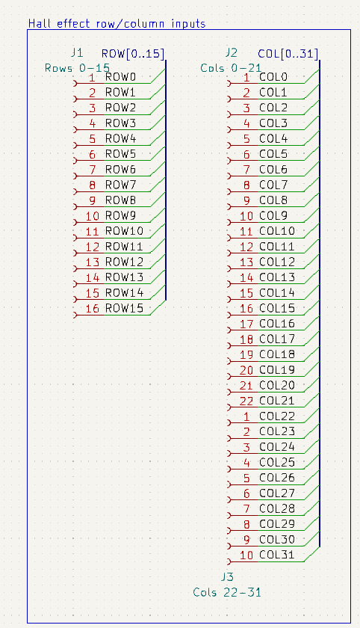
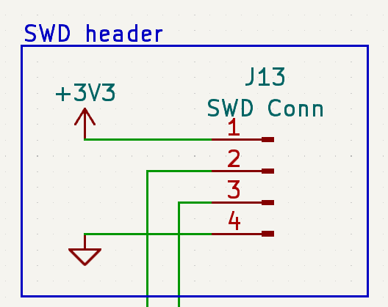
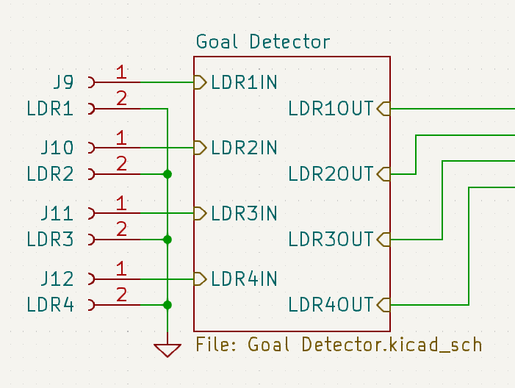
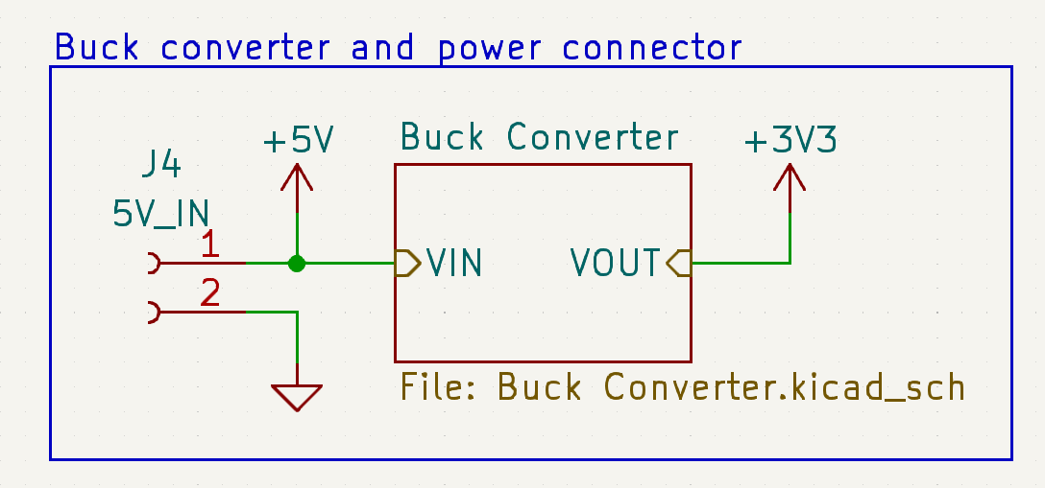
Electrical Schematic: Master PCB
External Connectors (Inputs)

Slide 36
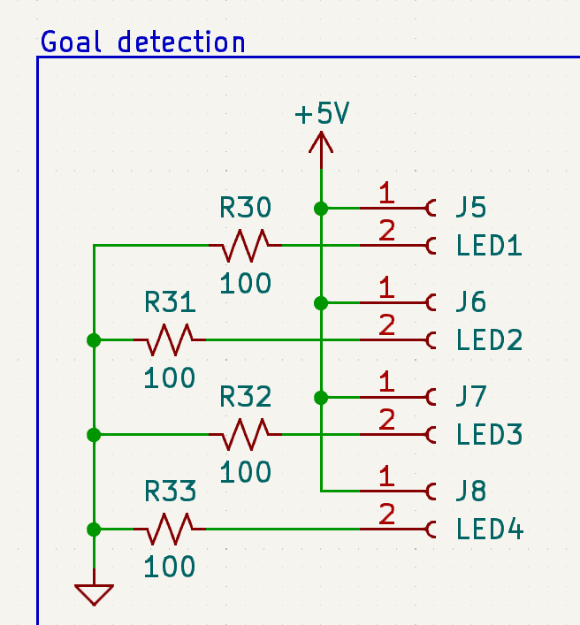
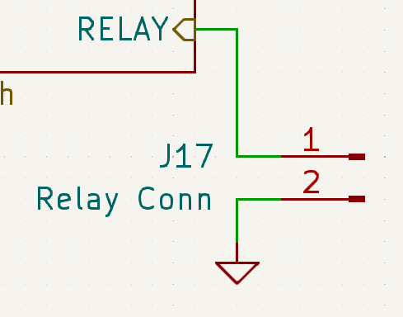
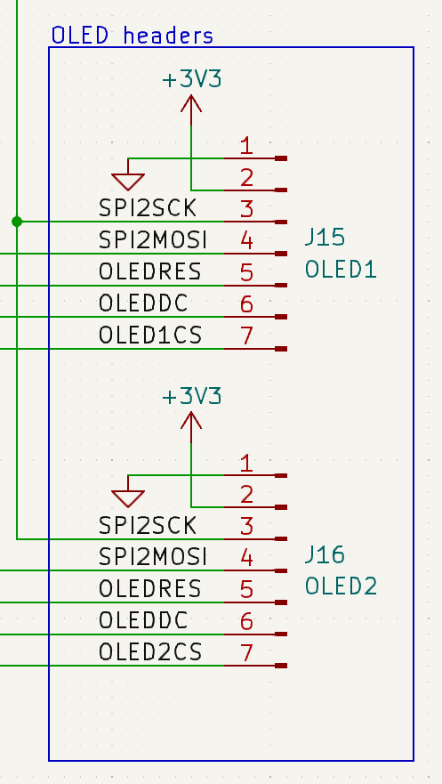
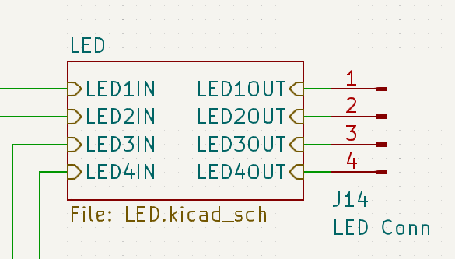
Electrical Schematic: Master PCB
External Connectors (Outputs)

Slide 37
PCB Layout – Master PCB

Slide 38
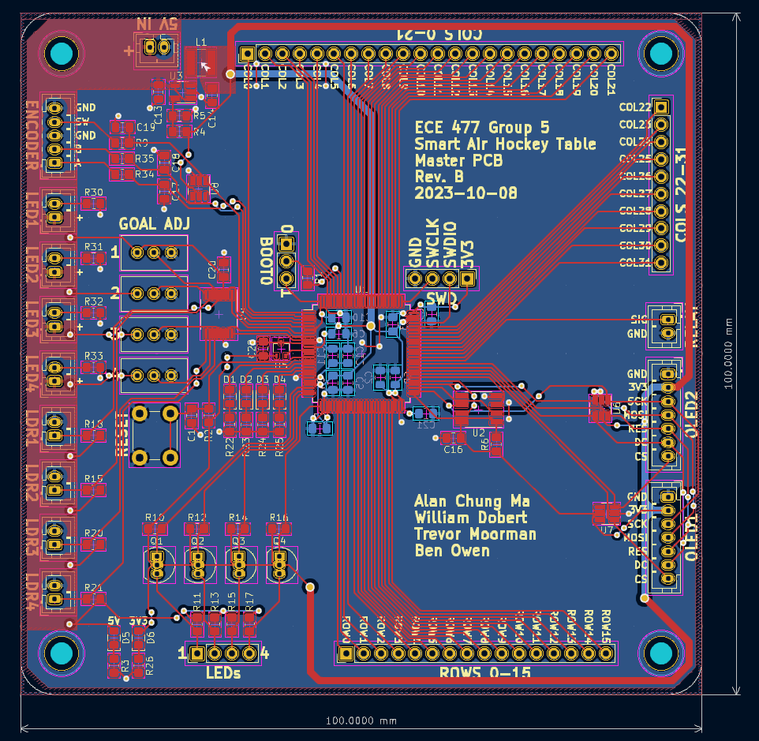
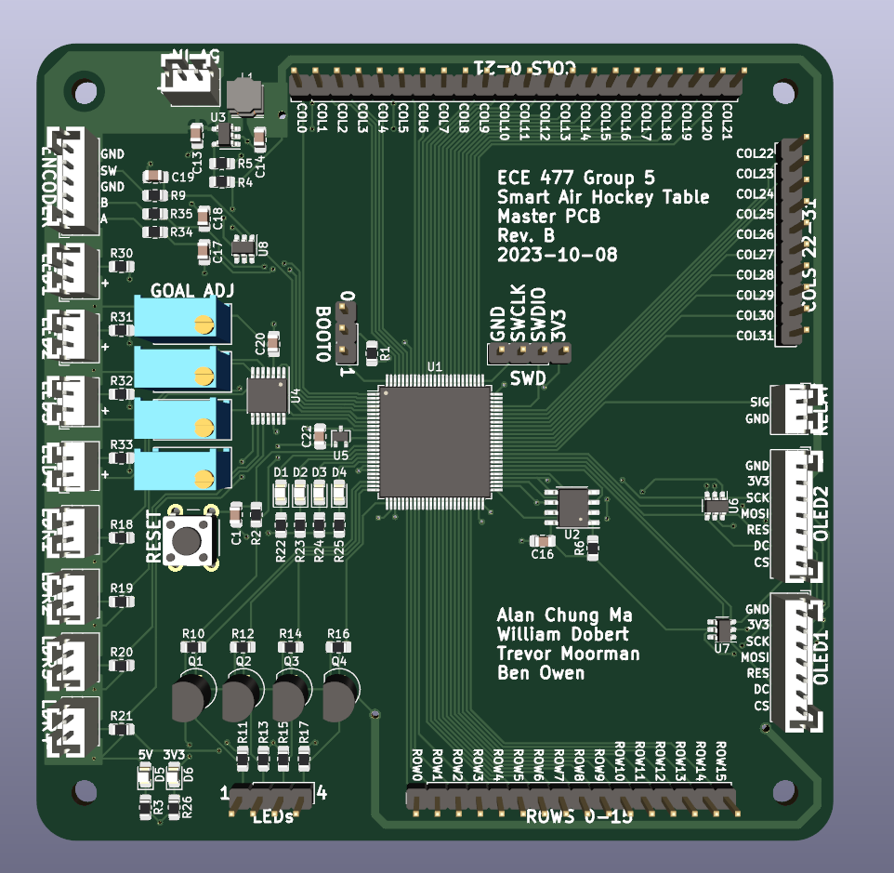
PCB Layout: Master PCB
Overview

Slide 39
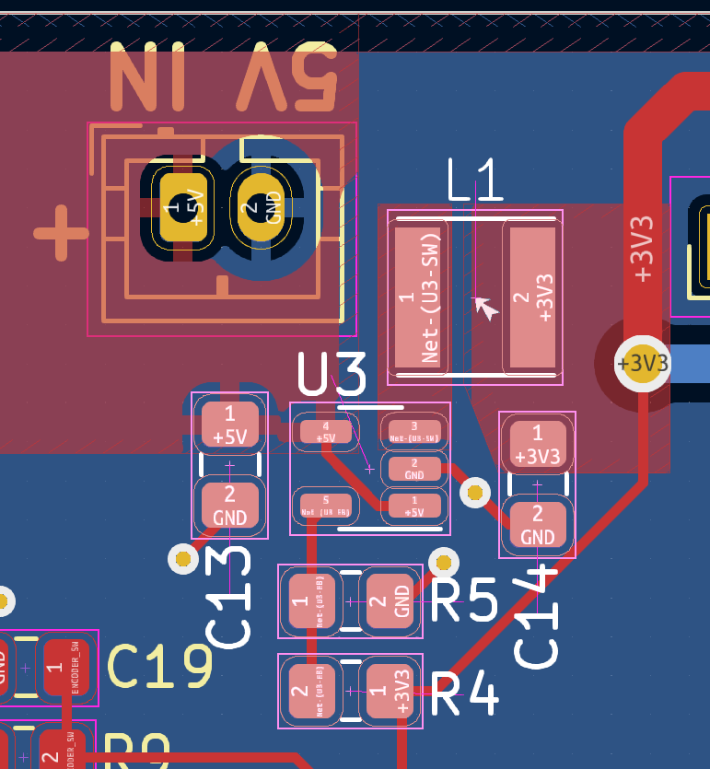
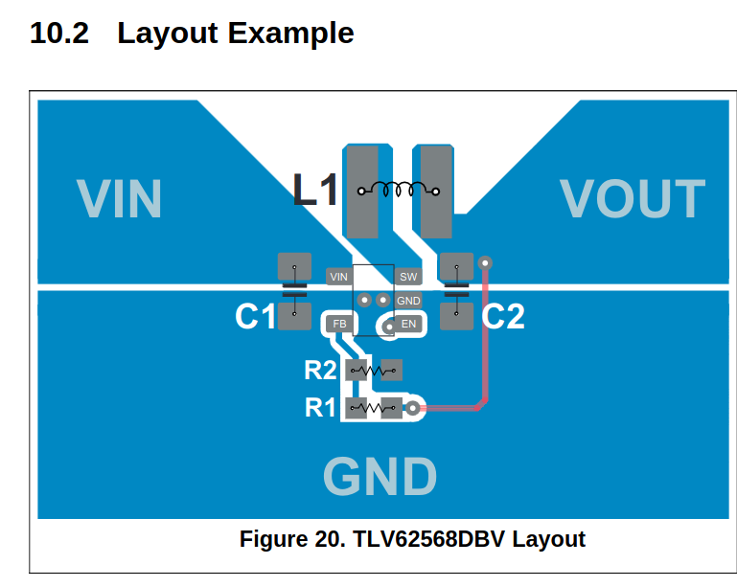
PCB Layout: Master PCB
Buck Converter

Slide 40
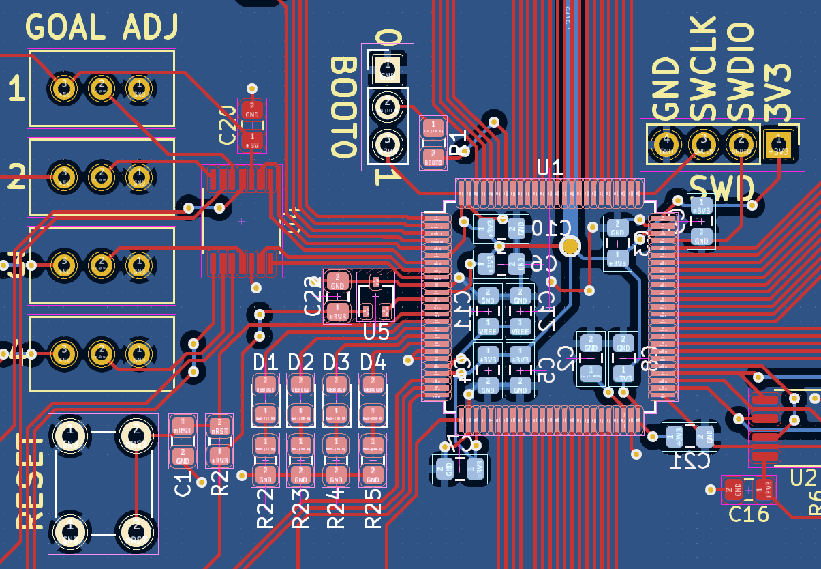
PCB Layout: Master PCB
STM32

Slide 41
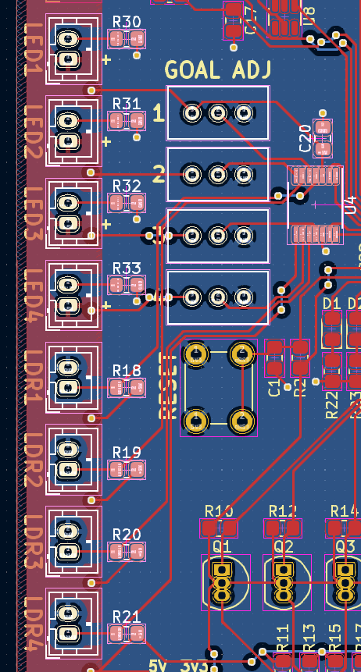
PCB Layout: Master PCB
Goal Detection

Slide 42
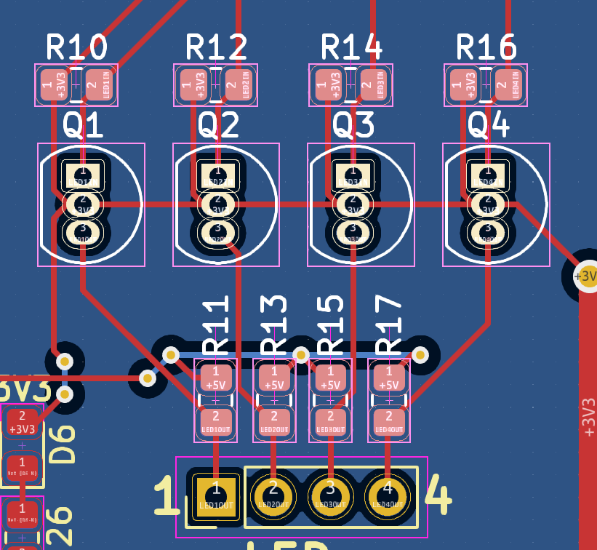
PCB Layout: Master PCB
LED Level Shifters

Slide 43
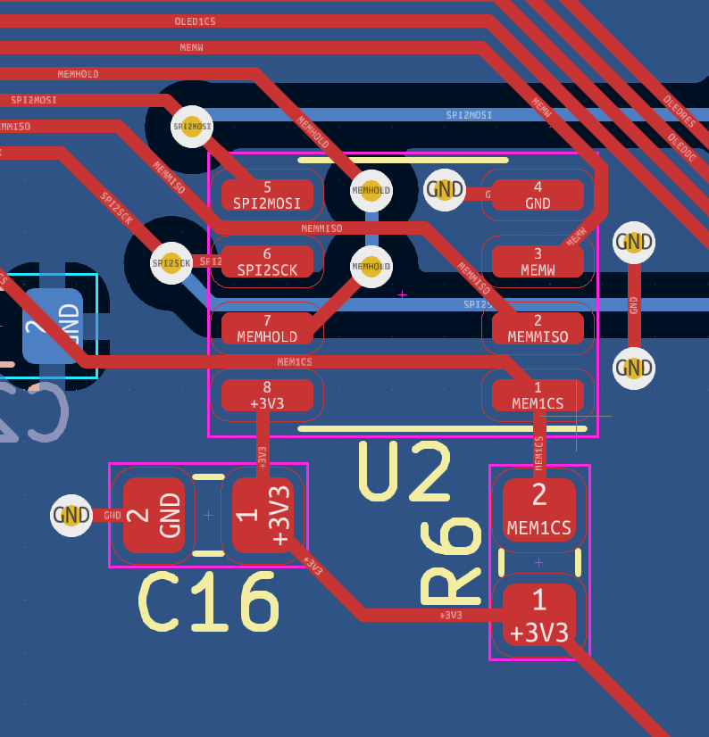
PCB Layout: Master PCB
EEPROM

Slide 44
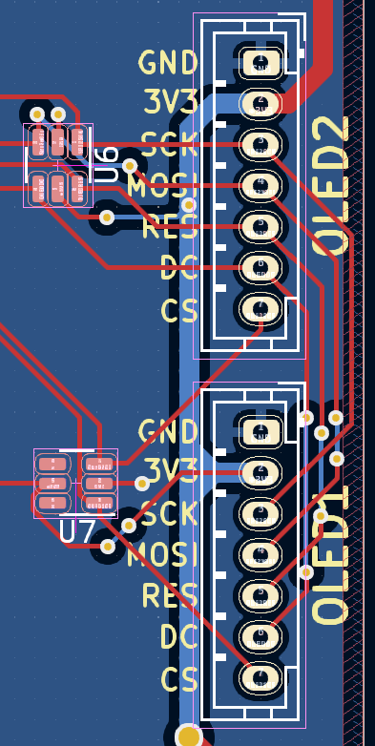
PCB Layout: Master PCB
OLED Connectors

Slide 45
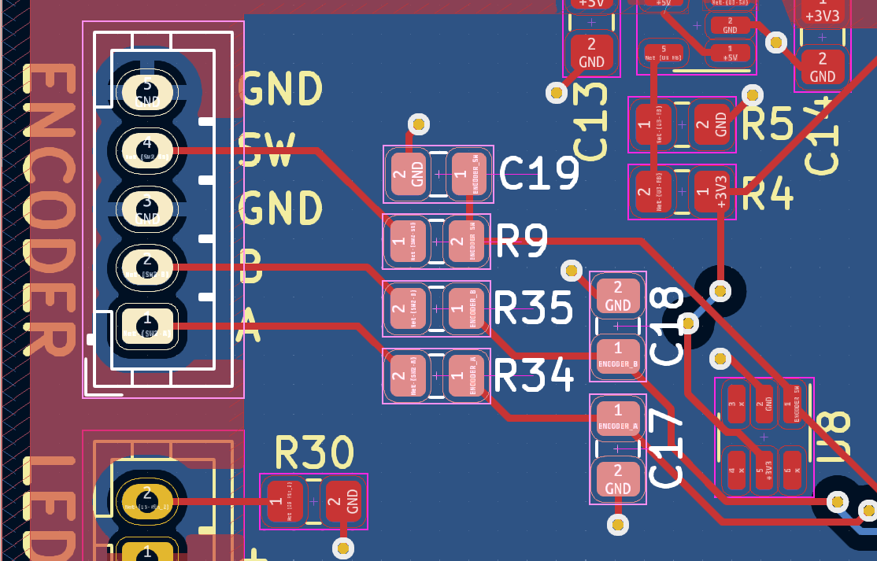
PCB Layout: Master PCB
Menu Encoder

Slide 46
Footprint Verification: Master PCB

Slide 47
Electrical Schematic – Sensor PCB

Slide 48
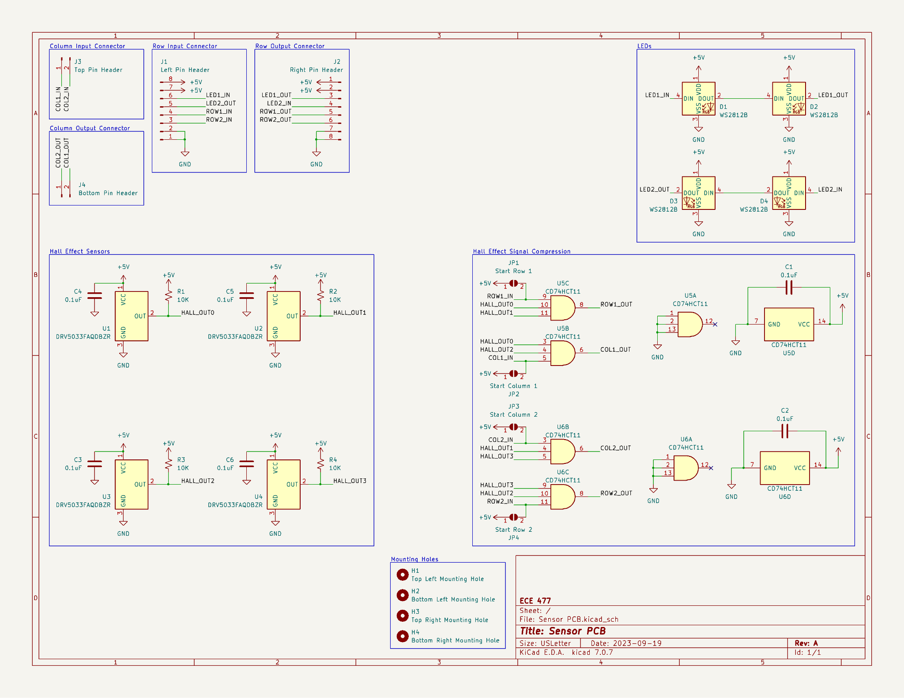
Electrical Schematic: Sensor PCB
Overview
Notes:
The Smart Air Hockey Table will consist of 128 sensor boards, 8 rows going length-wise along the table and 16 columns going width-wise across the table
Each sensor board includes 4 hall effect sensors and 4 associated LEDs, thus the Smart Air Hockey Table will have 512 hall effect sensors and LEDs
Each sensor board is connected to its adjacent neighbors in its row and column

Slide 49
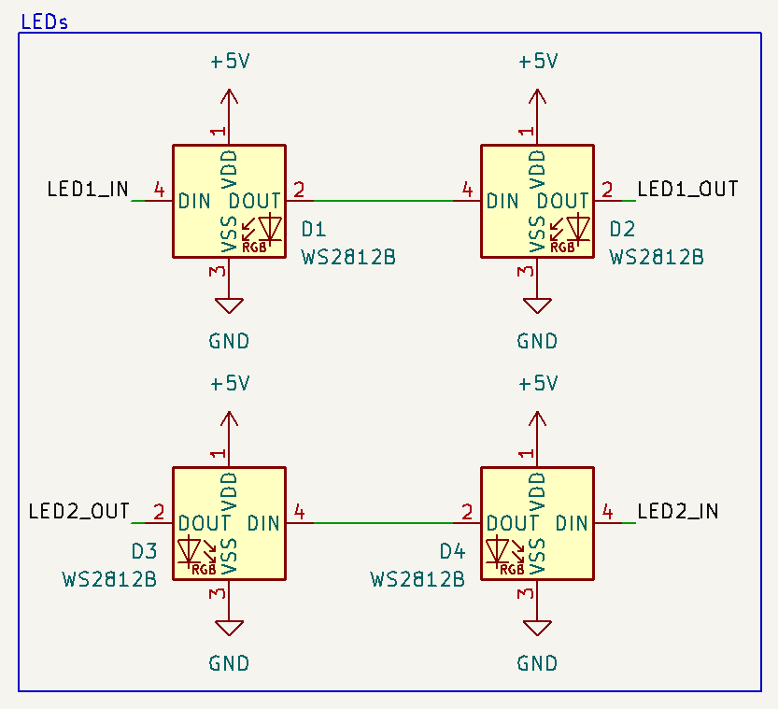
Electrical Schematic: Sensor PCB
LEDs
Notes:
(Point out how data “snakes” from top row of LEDs to bottom row of LEDs to limit necessary wiring)

Slide 50
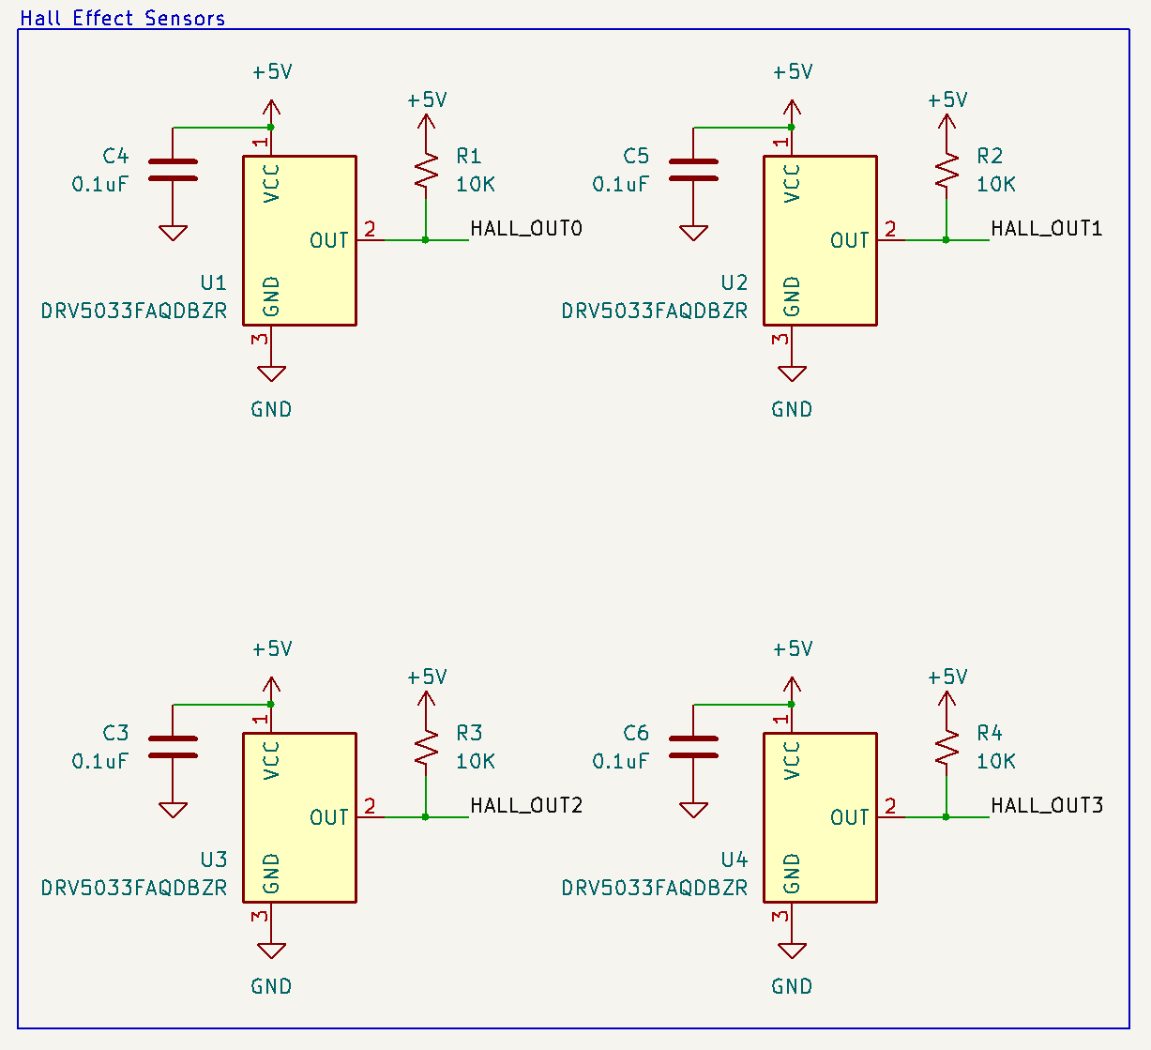
Electrical Schematic: Sensor PCB
Hall Effect Sensors
Notes:
Each hall effect sensor includes a decoupling capacitor attached to its V_CC input to reduce noise, as required by the sensor’s datasheet
Given that the hall effect sensor is open-drain, each sensor includes a pull-up resistor connecting the output to +5 V. Therefore, logic low is output when a magnet is detected

Slide 51
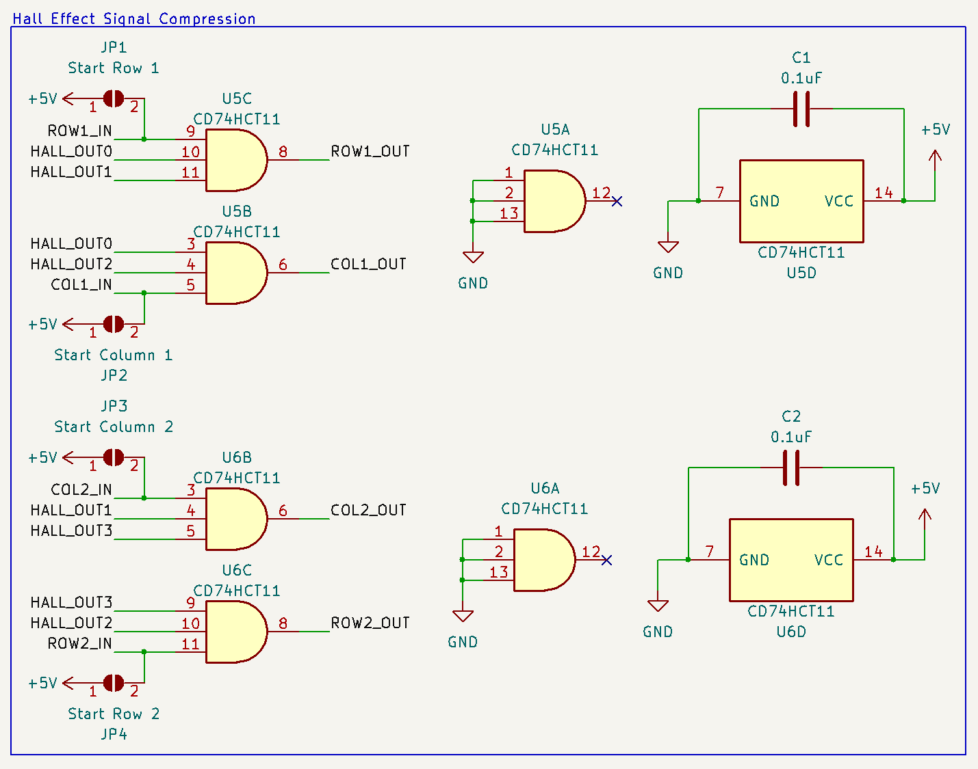
Electrical Schematic: Sensor PCB
Hall Effect Signal Compression
Notes:
Ignoring the obvious logistical issues, our microcontroller is unable to read all 512 hall effect sensors, thus some form of compression is required
Each row and column of hall effect sensors’ outputs are combined together into a single digital output. The puck is marked as being present on the row or column if any of the sensors in that row or column detect the puck, effectively acting as a line break
Note that each sensor board contains two rows and two columns of hall effect sensors.
Since the puck’s presence is marked by logic low, each row and column of hall effect sensors’ outputs are ANDED together to get the compressed value. The puck is detected in that row or column if the resulting AND gate output is logic low.
Hall effect sensor signals are compressed into a single output at each board. (Include more detailed description of how sensor data is passed along sensor boards)
(Point out solder jumpers are present for beginning of row and column)

Slide 52

Electrical Schematic: Sensor PCB
External Connectors
Notes:
+5 V and ground are shared through rows. The dupont wires that will connect the sensor boards can carry up to 3 A of current, thus two +5 V and two ground inputs are present to ensure we do not come near this limit.
(Tie data inputs and outputs to previous discussion of compression)

Slide 53
PCB Layout – Sensor PCB

Slide 54


PCB Layout: Sensor PCB
Notes:
Each hall effect sensor is spaced 50 mm apart
Each hall effect sensors’ associated LED is placed as close as possible
Central hole to allow airflow through PCB if needed
Angled pin headers are placed on the board so wires can be securely attached if necessary and to prevent headers from getting accidentally bent or otherwise damaged
Four mounting holes included, one in each corner, so the sensor board can be screwed into the table for stability and to ensure the hall effect sensors are precisely located

Slide 55

Footprint Verification: Sensor PCB

Slide 56
Prototyping Progress

Slide 57

Prototyping Progress
LED Matrix
Notes:
LED Matrix: Driver firmware is fully functional. Tested with assembled sensor PCBs, integration testing will occur once Master PCB Revision B arrives

Slide 58

Prototyping Progress
LED Matrix
Score-Tracking Display (OLED)
Notes:
Score-Tracking Display: Driver firmware is fully functional. Tested with one display, already has support for two

Slide 59

Prototyping Progress
LED Matrix
Score-Tracking Display (OLED)
Goal Detection LDR
Notes:
Goal Detection LDR: Tested design on a breadboard, will require further testing with on-board potentiometers once Master PCB Revision B arrives

Slide 60

Prototyping Progress
LED Matrix
Score-Tracking Display (OLED)
Goal Detection LDR
Push Button Rotary Encoder
Notes:
Push Button Rotary Encoder: Tested with manufacturer recommended analog filtering, but it behaved unexpectedly. Tested with microcontroller peripherals directly and it works great

Slide 61
Prototyping Progress
LED Matrix
Score-Tracking Display (OLED)
Goal Detection LDR
Push Button Rotary Encoder
Hall Effect Sensor Matrix
Notes:
Hall Effect Sensor Matrix: Tested with a magnet and assembled sensor PCBs, will continue to test as matrix size grows

Slide 62

Prototyping Progress
LED Matrix
Score-Tracking Display (OLED)
Goal Detection LDR
Push Button Rotary Encoder
Hall Effect Sensor Matrix
Blower Fan Power Control
Notes:
Blower Fan Power Control: Tested full length of power delivery equipment (wall outlet, relay, blower fan)

Slide 63

Prototyping Progress
LED Matrix
Score-Tracking Display (OLED)
Goal Detection LDR
Push Button Rotary Encoder
Hall Effect Sensor Matrix
Blower Fan Power Control
Buck Converter
Notes:
Buck Converter: Tested 5v to 3v3 conversion, have not tested powering the microcontroller with it yet

Slide 64
Prototyping Progress
LED Matrix
Score-Tracking Display (OLED)
Goal Detection LDR
Push Button Rotary Encoder
Hall Effect Sensor Matrix
Blower Fan Power Control
Buck Converter
Microcontroller
Notes:
Microcontroller: Fully soldered to Master PCB Revision A. Tested firmware flashing and runtime debugging

Slide 65
Software Development Status

Slide 66
Software Development Status
Software Component | Status
LED Matrix Driver | Completed*
Score-Tracking Display Driver | Completed*
State Machine | In Development
Goal Detection Driver | In Development
Push Button Rotary Encoder Driver | Not yet started
Hall Effect Sensor Matrix Driver | Not yet started
Blower Fan Power Control Driver | Not yet started
* Requires further testing with new microcontroller hardware
Notes:
LED Matrix Driver: Done
Score-Tracking Display Driver: Done, may iterate on visual touches if time allows
State Machine: In Development (Trevor)
Goal Detection Driver: External interrupts
Push Button Rotary Encoder Driver: Timer hardware and external interrupt
Hall Effect Sensor Matrix Driver: Poll 48 GPIO pins every tick (goal is 1 ms). Iterate on strategy for choosing puck location
Blower Fan Power Control Driver: Toggle a GPIO pin

Slide 67
Project Timeline

Slide 68
Project Timeline
Goal | Week 8 | Week 9 | Week 10 | Week 11 | Week 12 | Week 13 | Week 14 | Week 15 | Week 16
Driver Firmware Development
Table Construction at BIDC
Sensor PCB Assembly
State Machine Iteration
Small-Scale Integration Testing
Full Table Assembly
Full-Scale Integration Testing
Work on Stretch Goals
Thanksgiving Break
Notes:
Driver Firmware Development: 2 weeks left, shown on previous slide that only the simplest drivers are left
Table Construction at BIDC: Expected completion by Week 10. The sides need dado cuts and glued together. Plywood, MDF, and acrylic need to be cut down to size. Acrylic needs holes drilled
Sensor PCB Assembly: 3 weeks left, need to order more and keep soldering them together whenever we have extra time
State Machine Iteration: Continue iterating on the state machine over the next 6 weeks as needed
Small-Scale Integration Testing: Once Master PCB Rev. B arrives, begin integration testing between all components and a reduced size sensor PCB matrix
Full Table Assembly: Once table construction and sensor PCB assembly are complete, begin assembly of the full table with all components
Full-Scale Integration Testing: As the full table comes together, begin testing integration of components with the full-sized sensor PCB matrix. Find and fix every bug
Work on Stretch Goals: Use extra time on/after Thanksgiving break to work on stretch goals (settings menu, EEPROM memory expansion)

Slide 69
Questions

